Slide 1
Lab 8 – Text Mining with the Google Ngram Viewer
Hands on searches
Advanced searching features
Original research
Team presentation / discussion
Notes:
USE https://hide.me/en/proxy to hide the IP address of Furman for this lab.

Slide 2
Instructions
Get together with your final project team.
Load the Ngram viewer (https://books.google.com/ngrams)
Spend 20 minutes experimenting with example searches from lecture, and from pages 214-237 of the text. Make a note of interesting/witty results for later.
Work through the rest of these Powerpoint slides on advanced search techniques. Try each of the examples given plus at least one more search of the same type that you devise yourselves.
As a team, devise the most interesting/revealing/funny search you can think of. Don’t settle for your first idea. Try several and decide which is the best. Make a screen capture and send it to me with your team names.
At 3:15 p.m. each team will have 5 minutes to present and explain its mini-project results, including a discussion of what causality might underlie it, or what interesting hypotheses you might have about some underlying causality.

Slide 3
Notes
Other than the screen capture, there is nothing to turn in for this lab. But full and enthusiastic participation will be expected. Please don’t sit by while your teammates experiment.
Experimentation is the key to this activity. Have fun with it. There is no point in rushing, as everyone will be engaged until 4:00 or so.
Participation from the whole class is expected during the presentation part. In class these demonstrations have tended to make things very lively. I expect the same effect in lab – lots of insights, with a few laughs thrown in.

Slide 4
Basic Searches for Fun and Profit
Try out:
Pp. 214-237 in uncharted
Lecture examples
Other examples found online

Slide 5
(Somewhat More) Advanced Searches
Try out:
Wildcard Extractions
Inflection Searches
Case Sensitivity / Case Insensitivity
Accessing Tagging (as for Parts of Speech)
Richer Combinations
Some Boolean-based queries
Starts and ends of sentences

Slide 6
Wildcard Search *
The use of * to stand in for a word so the Ngram Viewer will display the top ten substitutes (of most common stand-in words) for the asterisk

Slide 7
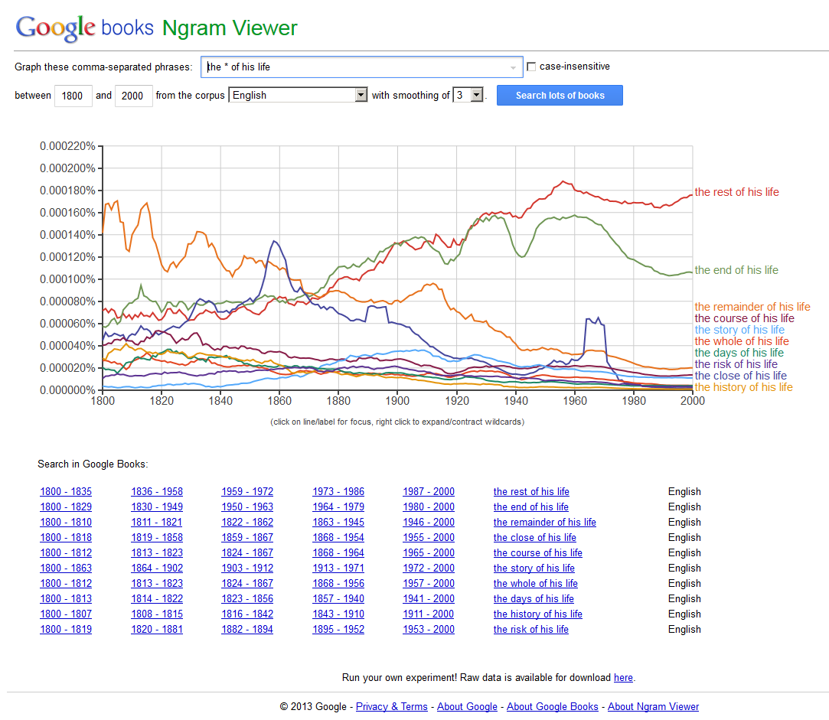
<the * of his life>

Slide 8
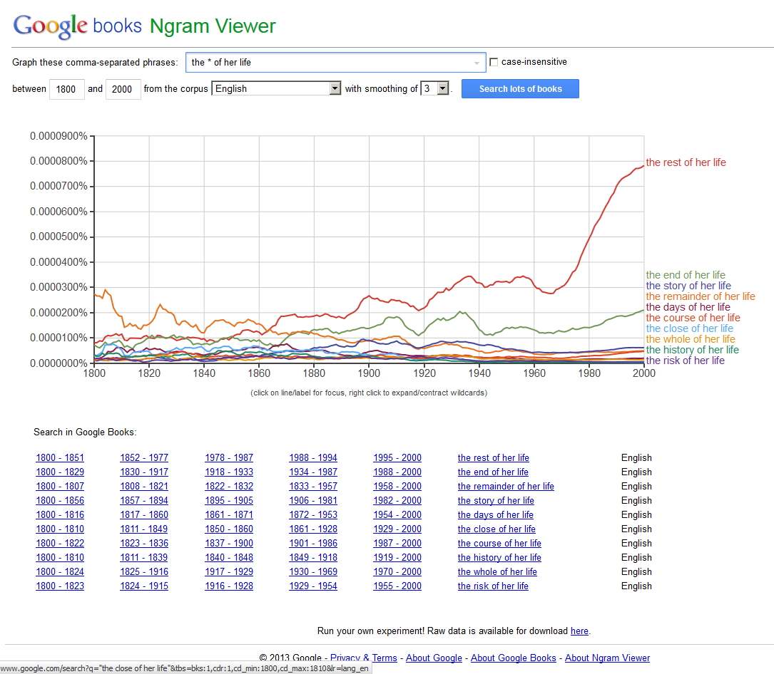
<the * of her life>

Slide 9
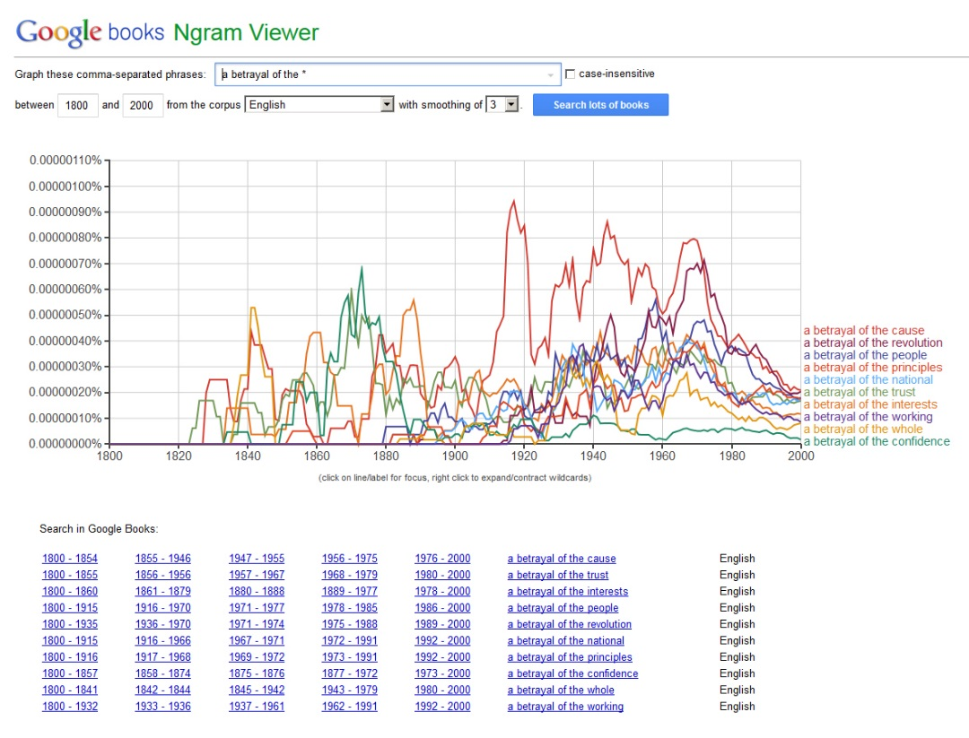
<a betrayal of the *>

Slide 10
Inflection Search with _INF
Differentiation of various word forms
(infinite verb form)
-ed
-ing
-s
(irregular spellings)

Slide 11
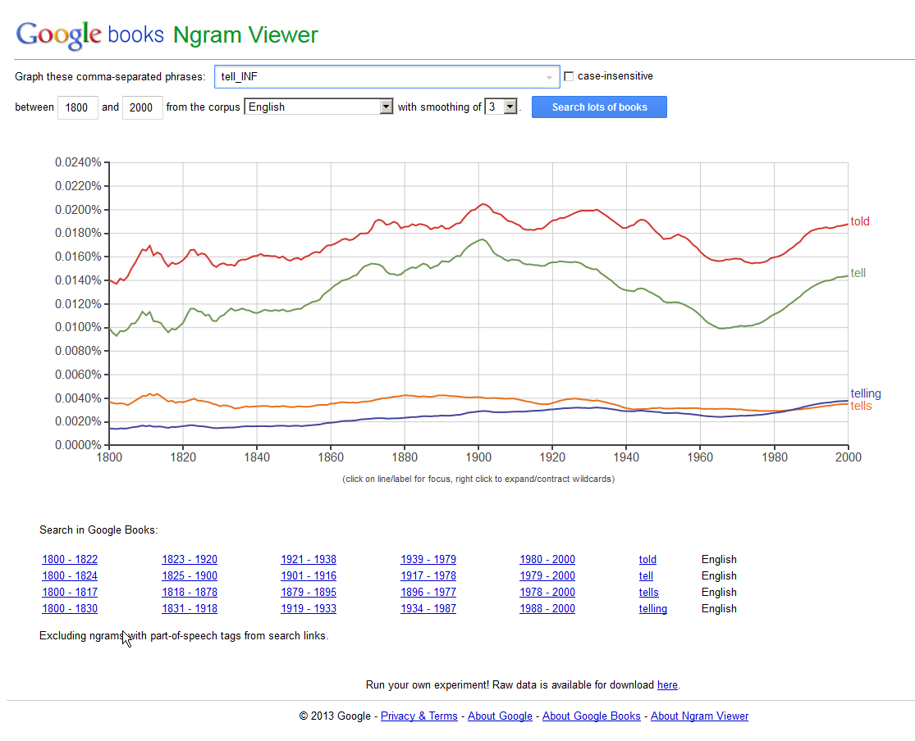
<tell_INF>

Slide 12
Case Sensitive / Insensitive Searches
Case Sensitive
Case Insensitive
Capitalizations and lower cases matter
Capitalizations and lower cases do not matter
Case insensitivity will result in a variety of capitalization / lower case mixes and variations for a particular search term

Slide 13
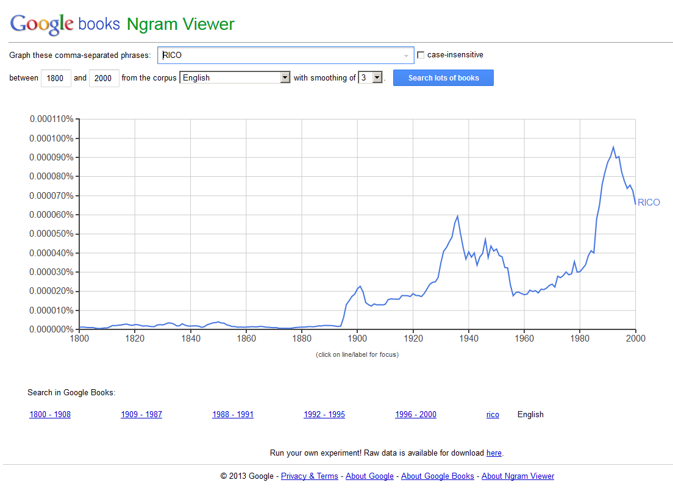
Case Sensitive <RICO>

Slide 14
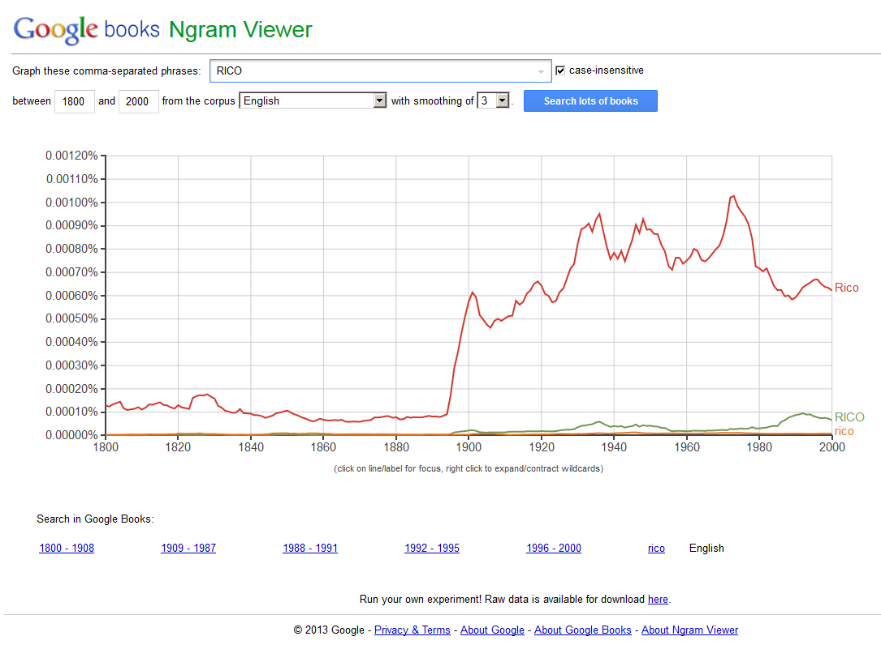
Case Insensitive <RICO>

Slide 15
Part-of-Speech Tags
Disambiguation of term to defining its usage as a part-of-speech to capture the conceptual usage
May be used as stand-alones (_VERB_) or appended to a verb (play_VERB)

Slide 16
TAGS | APPLICATION
_NOUN_ | Noun
_VERB_ | Verb
_ADJ_ | Adjective
_ADV_ | Adverb
_PRON_ | Pronoun
_DET_ | Determiner or article
_ADP_ | Adposition (preposition or postposition)
_NUM_ | Numeral
_CONJ_ | Conjunction
_PRT_ | Particle
_ROOT_ | Root of the parse tree
_START_ | Start of a sentence (sentence boundary)
_END_ | End of a sentence (sentence boundary)

Slide 17
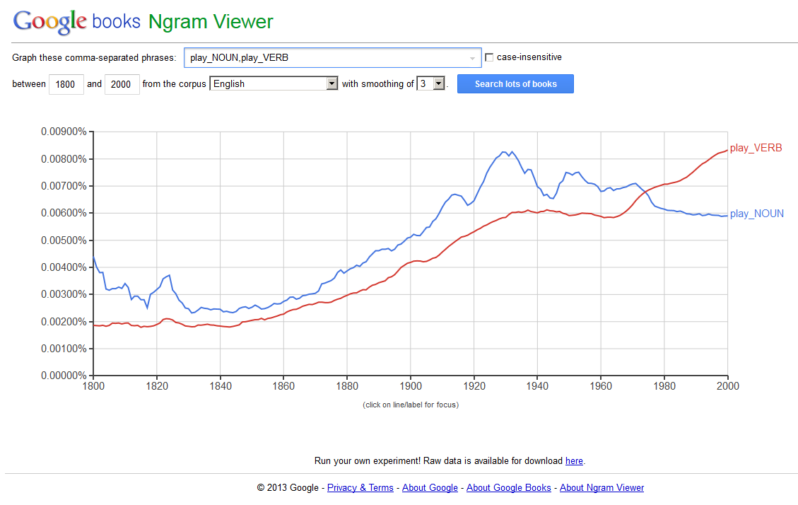
<play_NOUN, play_VERB>

Slide 18
Some Combinations
Inflection keyword with part-of-speech text
buy_INF, buy_VERB_INF (buy, buying, bought, buys)
Dependencies with wildcards
ride=>*_NOUN (ride car; ride bike; ride bus)
Notes:
Compare to ride=>* which includes “ride to”, “ride over”, etc.

Slide 19
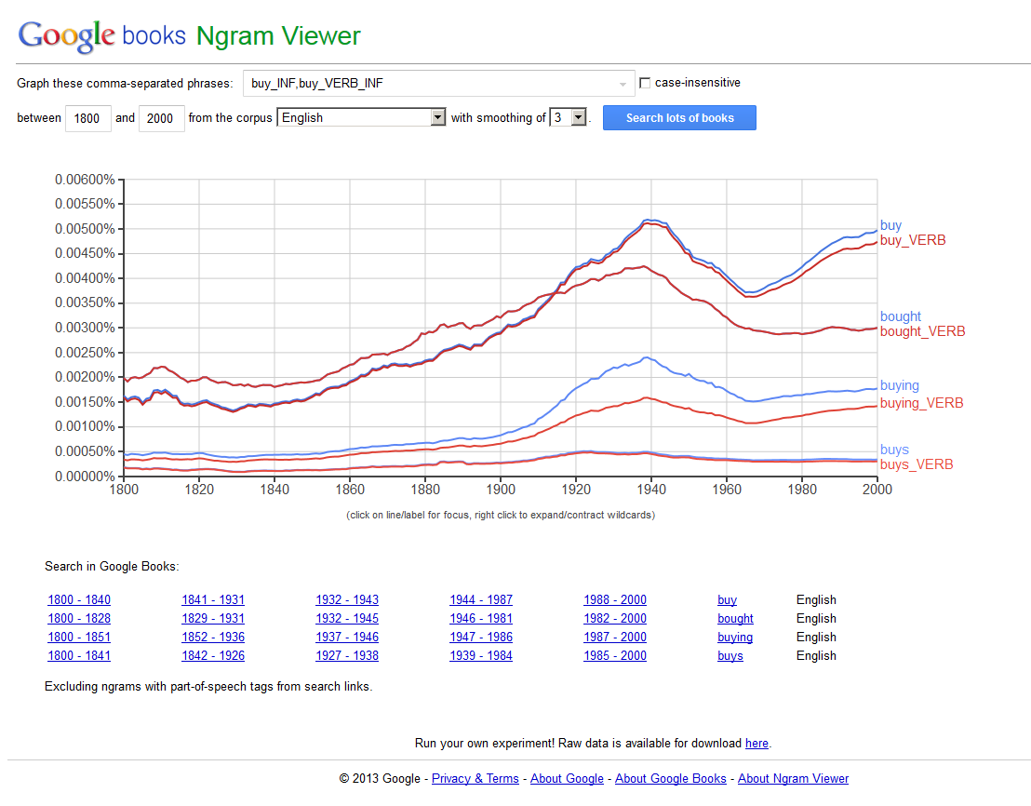
<buy_INF, buy_VERB_INF>

Slide 20
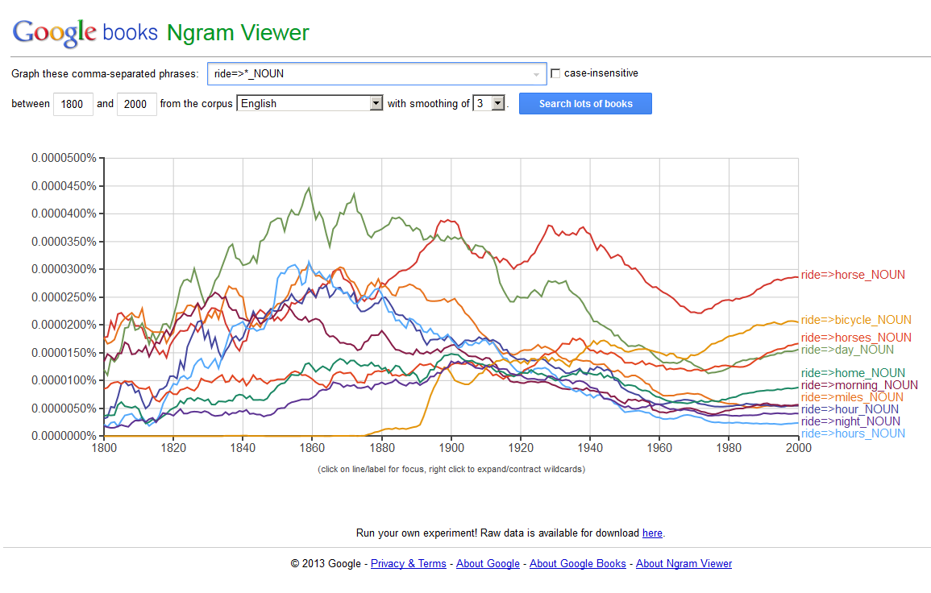
<ride=>*_NOUN>

Slide 21
Ngrams at the Starts and Ends of Sentences
Sentence Boundary Indicators
_START_
_END_

Slide 22
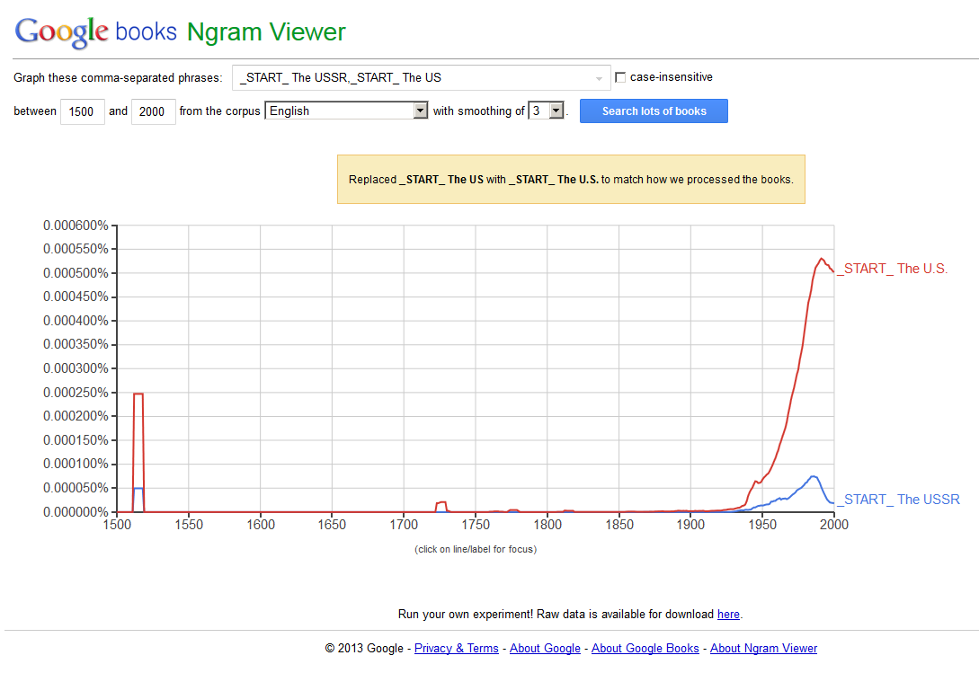
<_START_ The USSR,_START_ The US>

Slide 23
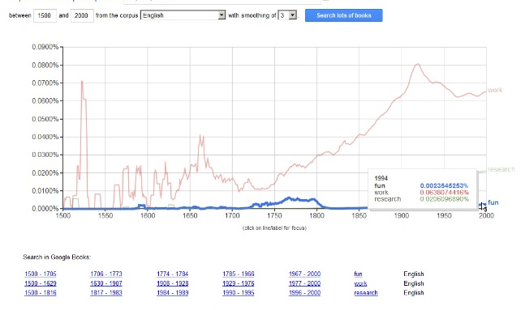
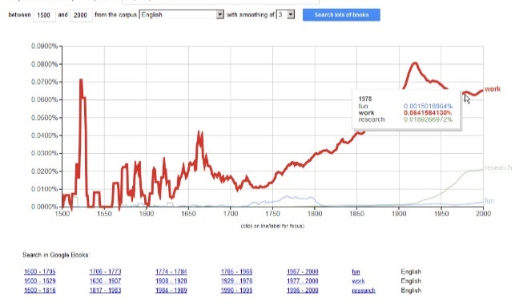
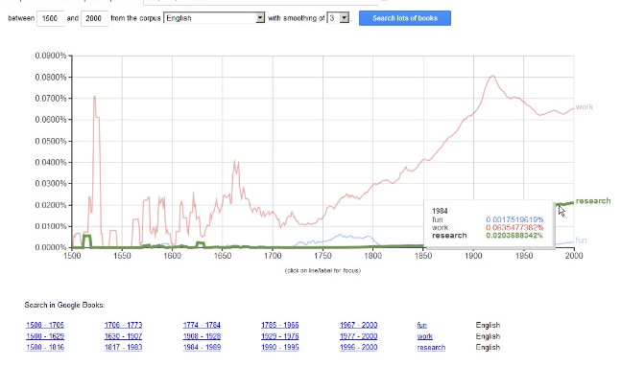

Any Ideas for Using the Ngram Viewer for your Fun, Work, and Research?
Fun
Work
Research
Stories to tell friends
Insights that may affect knowledge and decision-making
Citable information from the world’s collective knowledge conveyed through books…

